Slide 1
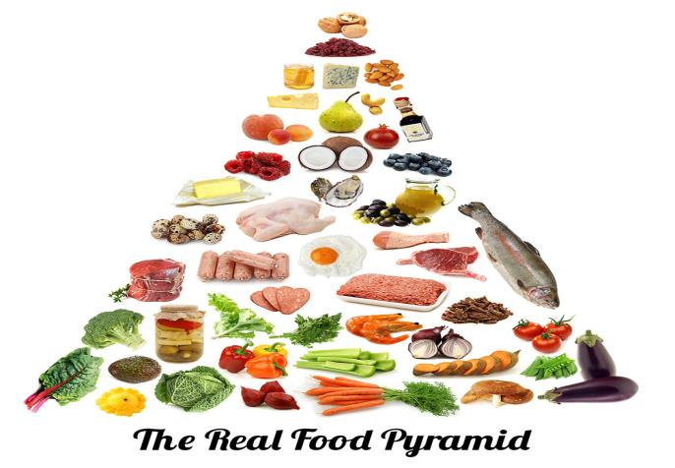
الطـعـام

Slide 2
Objectives
By the end of the lesson, the students will be able to:
1- talk about their favorite foods.
2- Ask and answer questions about the food they like.
3- Know about typical Egyptian dishes.
4- Compare a typical Egyptian meal with an American one.

Slide 3
Day 1

Slide 4
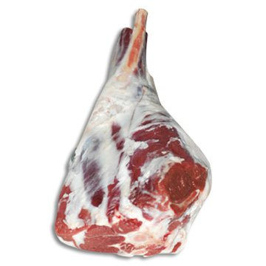
لَحم / لُحُـوم

Slide 5
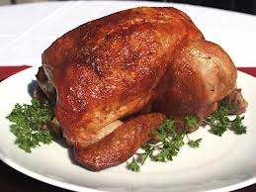
دَجَاج

Slide 6
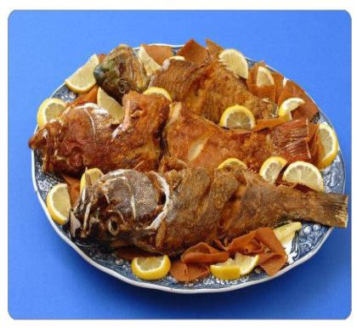
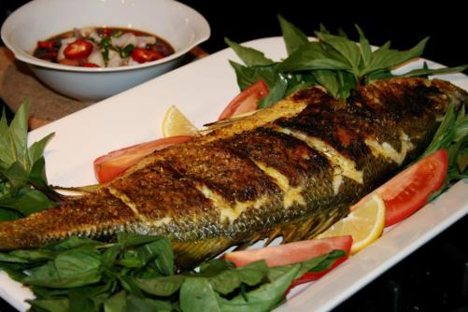
سَمَك / أَسمَاك

Slide 7
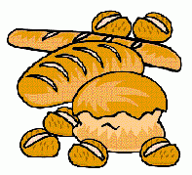
خُبز

Slide 8
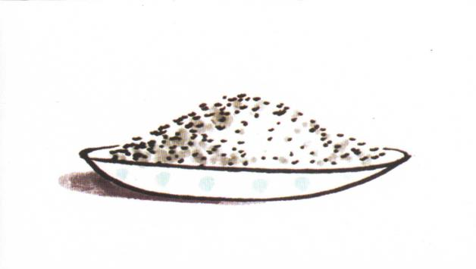
أُرز

Slide 9
بَيض

Slide 10
جُبن

Slide 11
Activity 1
Two students come to the board and the teacher says the words of the pictures and each students try to point to the correct picture faster than the other to win.

Slide 12


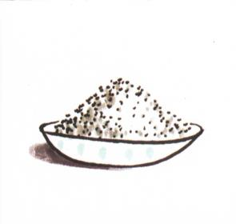

Slide 13
Activity 2
The students look carefully and find which kind of food is missing.

Slide 14
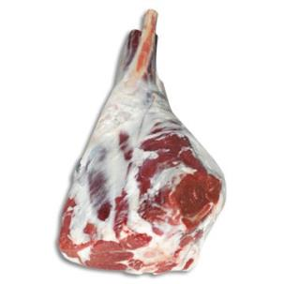


Slide 16


Slide 17
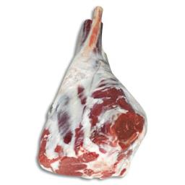


Slide 18


Slide 19


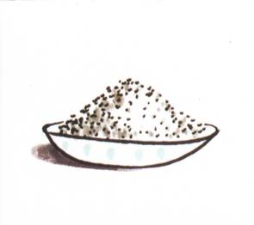

Slide 20



Slide 21

ماذا تحب ؟
أنا أحب ......

Slide 22
Day 2

Slide 23
Objectives
By the end of the lesson, the students will be able to:
Know the Arabic names of meals.
Know the Arabic names of drinks.

Slide 24
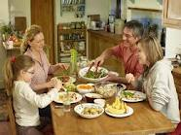
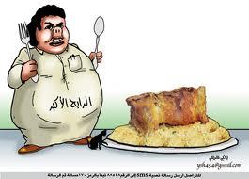
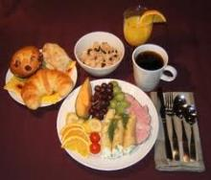
وَجبَة / وَجَبَات

Slide 25
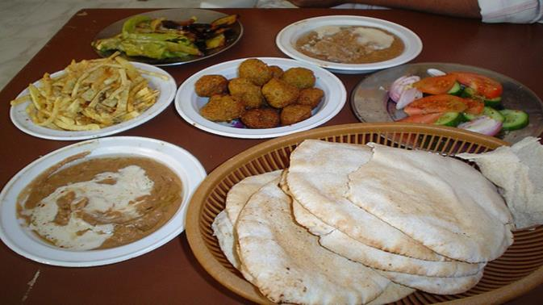
الفَطُور / الإِفْطَار

Slide 26
الغداء

Slide 27
العشاء

Slide 28
مشروبات

Slide 29

لَبَن / حَلِيب

Slide 30

عَـصِير

Slide 31

قَهْوَة

Slide 32

شَاىْ

Slide 33

مَاء

Slide 34
Activity 3
Two students come to the board and the teacher says the words of the pictures and each students try to point to the correct picture faster than the other to win.

Slide 35
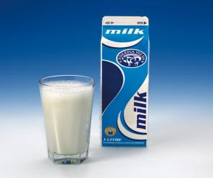



Slide 36
Activity 4
The students look carefully and find which drink is missing.

Slide 38


Slide 42
ماذا تحب أن تَشرَب ؟
أنا أحب أن أَشْرَب ....

Slide 43
Days 3-4

Slide 44
Objectives
By the end of the lesson, the students will be able to:
Know about the main components of every Egyptian meal.
Compare Egyptian and American meals.

Slide 45

وَجبَة فَطُور مِصْرِى

Slide 46
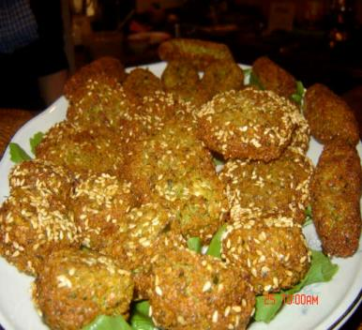
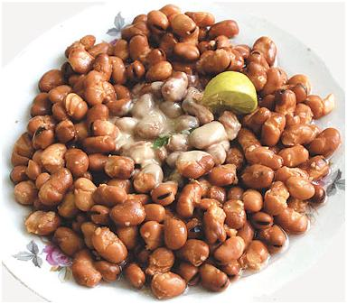
فَلَافِل / طَعمِيَة
فُـول

Slide 47
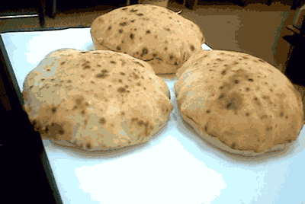
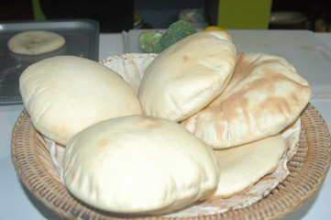
خُـبز

Slide 48
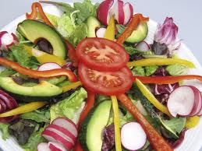
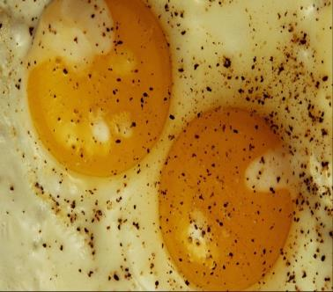
سَلَطَة
بَيض مَقلِى

Slide 49
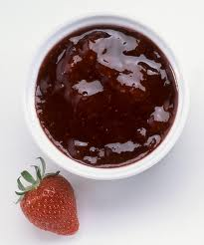
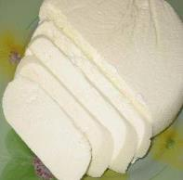
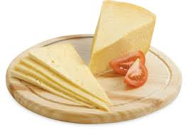
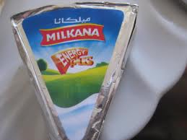
جُبن
مَربَى

Slide 50

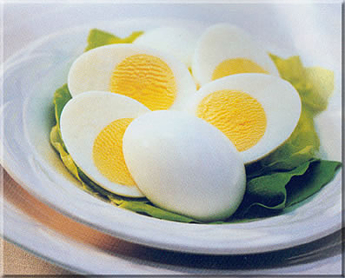
فَطَائِر
بَيض مَسلُوق

Slide 51
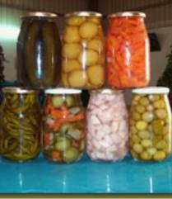
مِخلِل

Slide 52
How to make falafel
http://www.youtube.com/watch?v=2p_h3s1CPoc

Slide 53
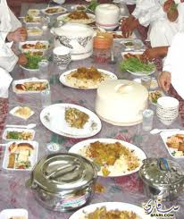
وَجبَة غَدَاء مَصرِى

Slide 54
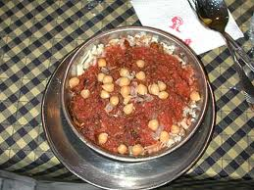
كُشَرِى

Slide 55
How to make Koshari
http://www.youtube.com/watch?v=Jtw8yVTmnMM
http://www.youtube.com/watch?v=Ek-Wz4G2Llo

Slide 56
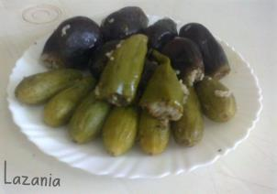
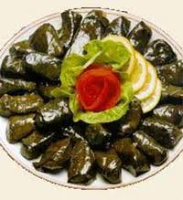
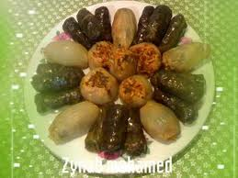
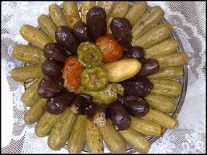
مَحشِى

Slide 57
How to make Stuffed Grape leaves
http://www.youtube.com/watch?v=1DlKlzltajg

Slide 58
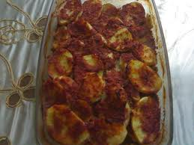
بَطَاطِس باللحم

Slide 59
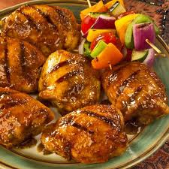
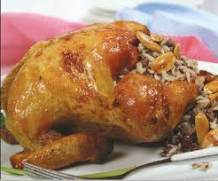
لَحم / لُحوم
دَجَاج

Slide 60
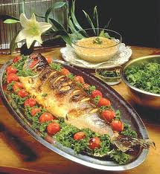
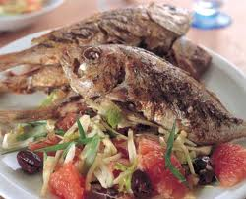
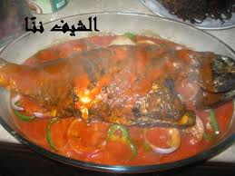
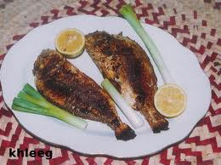
سَمَك / أَسمَاك

Slide 61
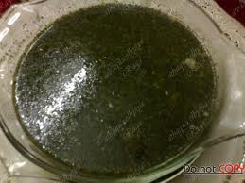
مُلُوخِيَة

Slide 62
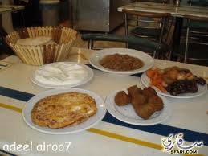
وَجبَة عَشَاء مَصرِى

Slide 63
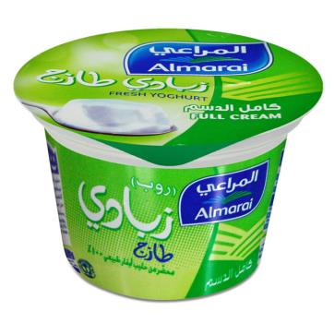
جُبن
زَبَادِى

Slide 64

بَيض مَقلِى
خُبز

Slide 65
شـكـرا
Prepared by:
Rezk Amer
Columbus International High School
TCLP 2013/2014

